Slide 1
Unit no 5
Agile methodology

Slide 2
Agile
5.1 Introduction to Agile Methodology
5.2 Agile Software Development lifecycle
5.3 Agile Methodology - Scrum Methodology, Kanban Methodology
5.4 Agile Practices - Sustainable Pace, Story Mapping, Test Driven Development, Pair Programming,
Unit Testing, Acceptance Testing, Agile Planning
5.5 Agile Metrics- BurnDown Chart, Lead Time & Cycle Time, Agile Velocity
5.6 Scaled Agile - Scaled Agile Frameworks

Slide 3
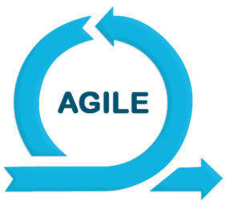
Introduction to Agile
Agile is an iterative approach for project management and software development. It helps teams to deliver value faster with greater quality and minimal effort. Agile encourages regular inspection and adaptation with each project development phase. Regular inspection in a software development life cycle allows teams to adapt to the changing variables quickly.

Slide 4
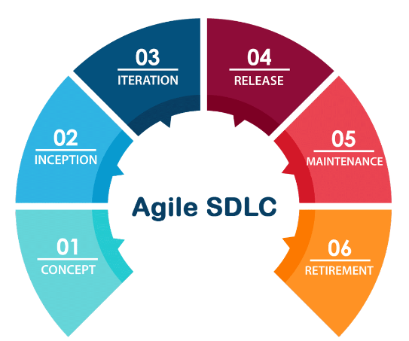
Agile SDLC – Software Development Lifecycle

Slide 5
Concept and Requirements
It is the first step towards initiating an Agile SDLC (Software Development Lifecycle). Product owners determine the scope and the requirements of their project with proper documentation. The essential requirements are then prioritized and shared by the product owner. The expected time and cost are mutually proposed and finalized by the production team and the project owner based on requirements. Once the concept is clear, the software development lifecycle will initiate.

Slide 6
Inception and Design
The second phase of the Agile Software Development Lifecycle is Inception or Design. In this phase, the architecture or design of the required project is proposed. A dummy UI design or blueprint is created by considering all the project requirements for a better product vision. For regular checks, this design is discussed with product owners to make them aware of the result. Once the design is approved and finalized, the actual production work will start.

Slide 7
Iteration or Construction
The next and important phase of the Agile SDLC is Iteration or construction. It is the longest phase where all the real work is done. The entire project is divided into different modules or chunks that are completed by multiple teams.
After dividing the modules, each module passes through multiple iterations till it satisfies the project requirement. Suppose if the module payment gateway needs to be finalized, then the following iteration will start.

Slide 8
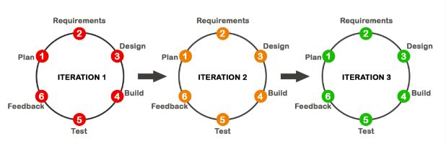

Slide 9
Plan: Everything starts with planning, and it helps to make the team aware of the task they need to perform.
Requirements: Module requirements are planned and gathered here.
Design: Based on the planning and requirements, a prototype is designed.
Develop Product: The product is developed here with programming and codes with all the security in mind.
Test Software: The product is tested here, and all bugs are fixed.
Incorporate Feedback: With feedback and suggested modifications by the team, the module continues with a new iteration till it gets finalized.
Once all the individual modules are finalized, they are combined to make the product ready for release.

Slide 10
Release and Production
The final product is tested by the Quality assurance team. All the potential bugs are fixed immediately by the production team. After completing all the test cycles, the product is approved by the product owner. The complete documentation of the final product is prepared at the end. With this final step, the final product is all set to get released.

Slide 11
Feedback and Maintenance
Each phase of the Agile SDLC has its own importance in making the final product more durable. Even though the product is fully deployed to the customers or end-users in the previous production phase, the work is not finished yet. The production team will provide ongoing support to monitor the product regularly and fix new bugs. With time additional upgrades and features can also be added to keep the product updated.

Slide 12
Retirement
It is the optional phase where the products are retired for either two reasons:
The product needs to be replaced with a completely new one. Here, support is ended for the existing product and users are migrated to the new product.
The product is no longer compatible or needed for the organization. Here, the product is no longer supported, and the final product closure is done.

Slide 13
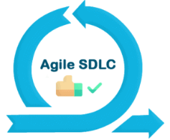
Advantages of Agile SDLC
The process is flexible and transparent in nature.
Fast and determined workflow for the team members.
Multiple iterations to cross-check the requirements with results.
Agile SDLC consists of various checkpoints where the customer can suggest modification wherever needed.
Minimal effort and better results

Slide 14
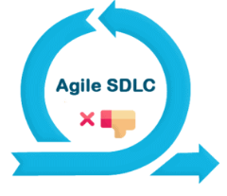
Disadvantages of Agile SDLC
The team should be highly professional and client-oriented.
More correction and modifications can lead to the more expected time.
New requirements can hinder the existing workflow.
With more iterations, the final cost can vary

Slide 15
Agile Methodology - Scrum Methodology, Kanban Methodology

Slide 16
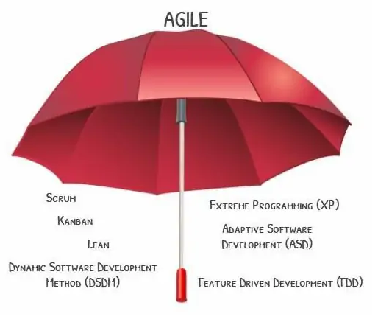

Slide 17
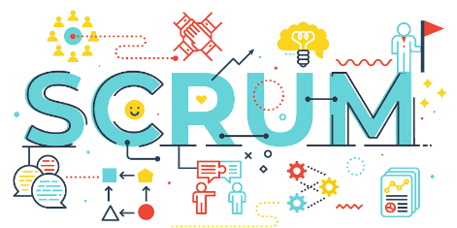

Slide 18
Scrum Methodology
Scrum is an agile development methodology used in the development of Software based on an iterative and incremental processes. Scrum is adaptable, fast, flexible and effective agile framework that is designed to deliver value to the customer throughout the development of the project.

Slide 19
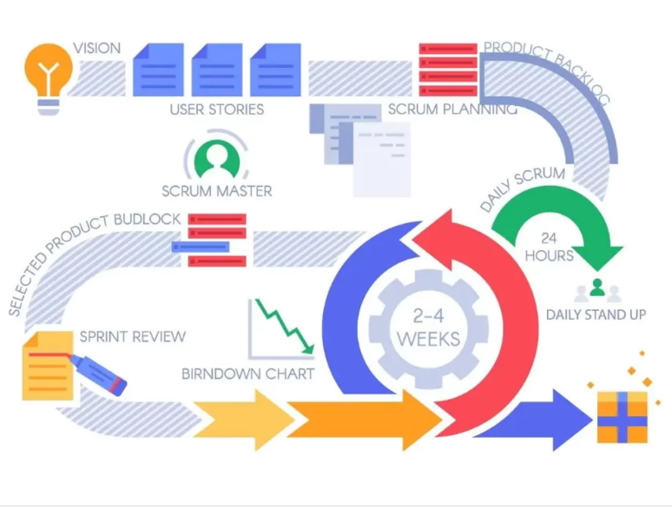

Slide 20
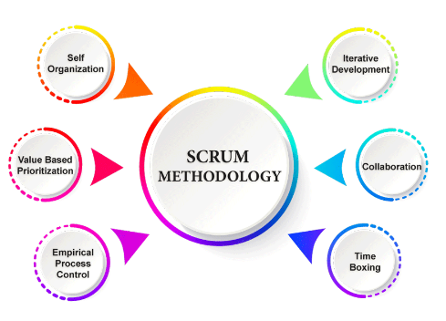
Principles of Scrum Methodology

Slide 21
Self-organization – Independence and importance of each individual.
Prioritization – Dividing tasks based on priority and value.
Collaboration – Teamwork and awareness.
Iterative Development – Regular project monitoring and improvement.
Timeboxing – Scheduling work in short cycles called sprints.

Slide 22
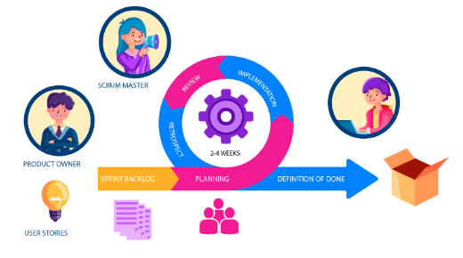
Who is Scrum Master?
Scrum Master leads the teams and becomes a median between the product owner and the scrum team.

Slide 23
Scrum Master Roles and Responsibilities
Project Management
Assist Product Owner
Monitor Progress and Resolve Conflicts
Follow Scrum Best Practices.
Scrum Master’s role is to act as a mentor to guide his team and follow best practices that lead to more productivity. It helps the team to stay more focused and dedicated to work.

Slide 24
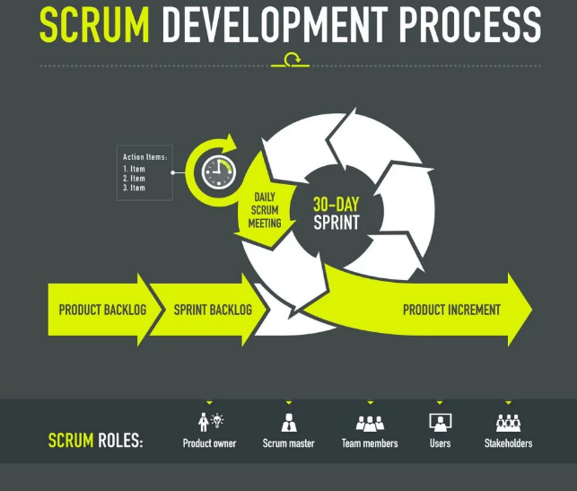

Slide 25
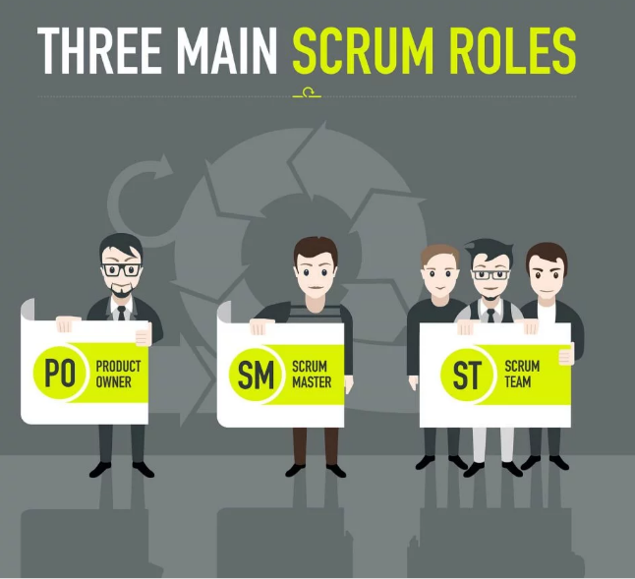

Slide 26
Different Roles in Scrum
Product owner (PO)
Is the representative of the stakeholders and customers who use the software. They focus on the business part and is responsible for the ROI of the project. They Translate the vision of the project to the team, validate the benefits in stories to be incorporated into the Product Backlog and prioritize them on a regular basis.
Scrum master
The person who leads the team guiding them to comply with the rules and processes of the methodology. Scrum master manages the reduction of impediments of the project and works with the Product Owner to maximize the ROI. The Scrum Master is in charge of keeping Scrum up to date, providing coaching, mentoring and training to the teams in case it needs it.

Slide 27
“It is the Scrum Master’s job to guide the team toward continuous improvement – to ask with regularity, “How can we do what we do better?”
Jeff Sutherland
Scrum Team
A group of professionals with the necessary technical knowledge who develop the project jointly carrying out the stories they commit to at the start of each sprint.

Slide 28
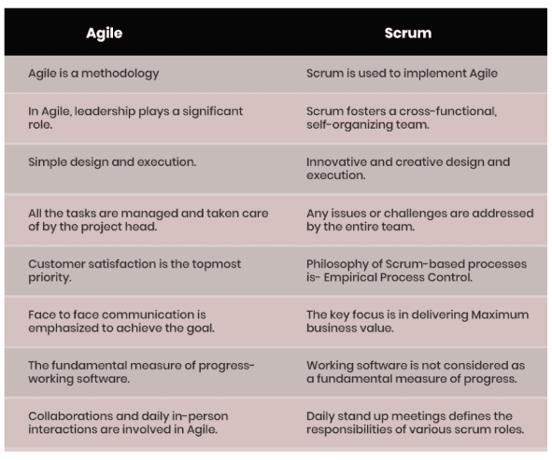

Slide 29
Kanban Methodology
Kanban is a visual system for managing work as it moves through a process.
Kanban visualizes both the process (the workflow) and the actual work passing through that process.The goal of Kanban is to identify potential bottlenecks in your process and fix them so work can flow through it cost-effectively at an optimal speed or throughput.

Slide 30
The four foundational principles and six Core Practices of the Kanban Methodology

Slide 31
Foundational Principles:
Start with what you are doing now
Agree to pursue incremental, evolutionary change
Initially, respect current roles, responsibilities and job-titles
Encourage acts of leadership at all levels

Slide 32
Core Practices of the Kanban Method
Visualize the flow of work
Limit WIP (Work in Progress)
Manage Flow
Make Process Policies Explicit
Implement Feedback Loops
Improve Collaboratively, Evolve Experimentally

Slide 33
How does Kanban work?
The Kanban board consists of three major components:
To-do: These represent items that need to be completed
Ongoing/Doing: These represent items that are being currently worked on by the team
Done: These are the tasks and items that have already been completed

Slide 34
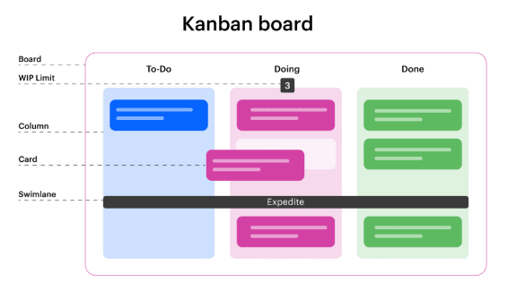

Slide 35
Agile Practices - Sustainable Pace, Story Mapping, Test Driven Development, Pair Programming, Unit Testing, Acceptance Testing, Agile Planning

